Slide 1
Data Communications for a Global Environment
Lecture 16

Slide 2
Chapter 7
Wireless
Local Area Networks

Slide 3
Three categories of wireless technologies: Wi-Fi, WiMAX and BlueTooth
All Three of these technologies us layer 2 (Data Link) protocols.
Thus these protocols have to be compatible with the layer above it (Network Layer) and the layer below it (The physical layer). These must meet the needs of the wireless protocols.

Slide 4
Wireless LANs (WLANs)
At the physical layer, WLAN’s use radio or infrared frequencies to transmit signals through the air (instead of cables)
Basic Categories
Use of Radio frequencies (FOCUS of this chapter)
802.1x family of standards (aka, Wi-Fi)
Use of Infrared frequencies (Optical transmission)

Slide 5
Wireless LANs (WLANs)
Microwave and Infrared technologies were competing technologies in the early development stages.
- Advantages of IR
o Easily reflected
o More secure than MW
o equipment is very inexpensive
- Major drawback of IR
o Most rooms have intense IR background radiation.
Microwave has become the predominant technology

Slide 6
Principal WLANs Technologies
WI-FI
- IEEE 802.11x
802.11n is the newest standard
a = 5.0 GHz,
b = 2.4 GHz, speed = 11 Mbps, d = 328’ indoors, 1312’ outdoors
g = 2.4 GHz, speed = 54 Mbps, d = 328’ indoors, 1312’ outdoors
n = 2.4 GHZ, speed = 270 Mbps
WIMAX
- IEEE 802.16
- fixed or mobile
Bluetooth
- IEEE 802.15

Slide 7
Components of WLANs
Network Interface Cards
Many laptops come with WLAN cards built in
Is a radio transceiver transmits and receives
over short distances
About 100-300 feet max transmission range
Access Points (APs)
Plays the same role as a Hub in a wired Ethernet LAN
Connects a WLAN to a wired LAN usually through a 100baseT connection.
Requires a separate source of power
a. via a normal electrical outlet
b. POE power over Ethernet connection

Slide 8
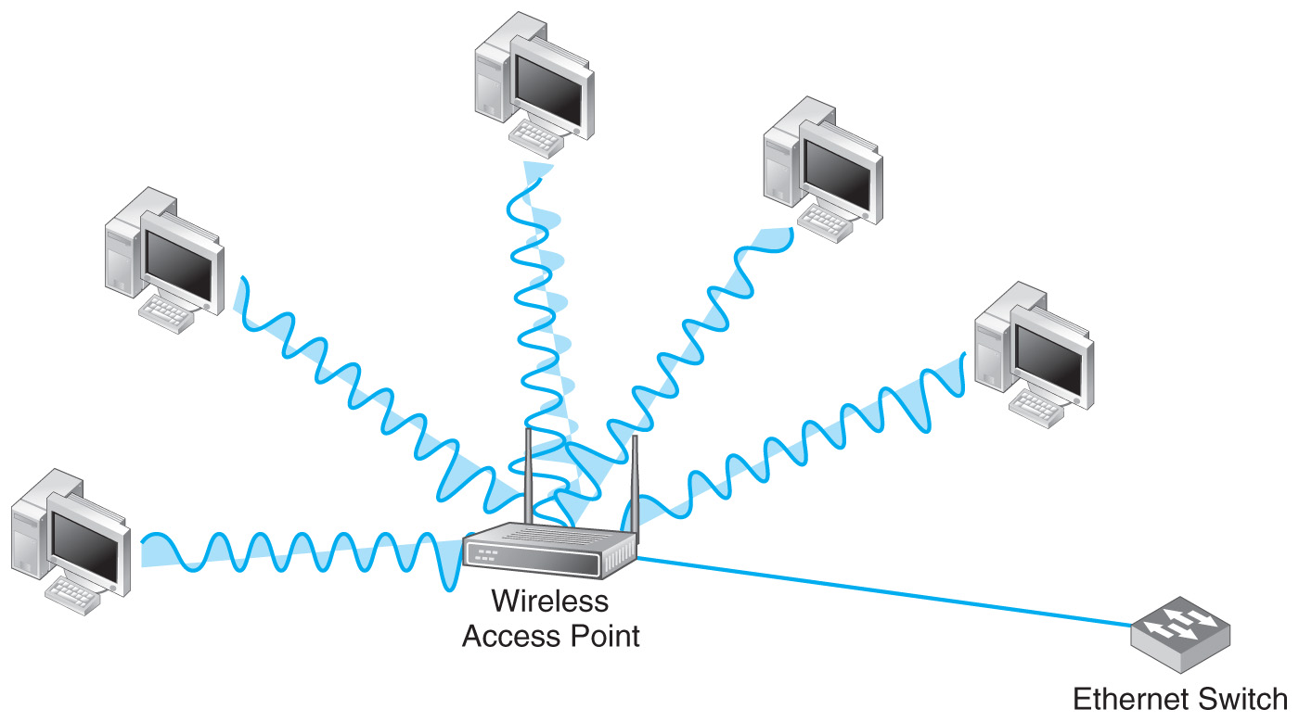
c07f001
Components of WLANs
Access Points
Main
LAN
powered device
guided media

Slide 9
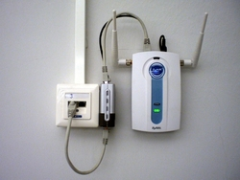
Components of WLANs
Advantages
Cheaper cabling — even category 5
cable is cheaper than USB repeaters.
A Gigabit of data per second to every
device is possible, which exceeds 2009
USB and the AC powerline networking
capabilities.
Global organizations can deploy PoE
everywhere without concern for any local
variance in AC power standards, outlets,
plugs, or reliability.
Direct injection from standard 48 V DC
battery power arrays; this enables critical
infrastructure to run more easily in
outages,
Symmetric distribution is possible. Unlike
USB and AC outlets, power can be
supplied at either end of the cable or outlet.
Power over Ethernet AP

Slide 10
Components of WLANs
Access Points (APs)
Act as repeater to ensure that all computers within range of the AP hear the signals of all other computers
Wireless NIC’s never communicate with each other directly. They always transmit to an AP. This doubles the number of transmissions in an WLAN.
Never place the server on the WLAN.
There are two type of AP antennas: omnidirectional and directional.

Slide 11
Characteristics of Radio Frequency Transmission
Most Countries allow WLANS to operate in two frequency ranges: 2.4 GHz and 5.0 GHz. Note that all other unlicensed devices also operate in this same range.
The frequency range directly affects the data rates that can be transmitted. The higher the frequency the greater the data rate.
Because radio waves are attenuated as they travel from the AP, the data rate drops off with distance from the AP. The higher the frequency the higher the attenuation rate and the shorter the transmission distance.
The vendor provided transmission distance is often over-stated. Absorbing barriers such as walls, noise and other factors can substantially reduce the effective transmission distance.

Slide 12
Characteristics of Radio Frequency Transmission
Each AP in a LAN is set to transmit at a different frequency (or channel) from any other AP in receiving distance to avoid interfering with each other.
When a computer on WLAN first starts up the NIC scans all of the channels within the appropriate frequency range and selects the one with the strongest signal strength.
NIC’s may scan for different channels if the user is roaming or the traffic on that channel becomes to busy.

Slide 13
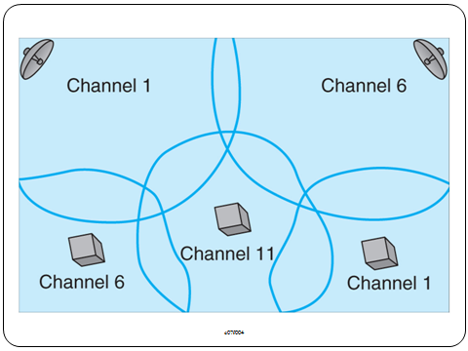
A WLAN Using Different Channels

Slide 14
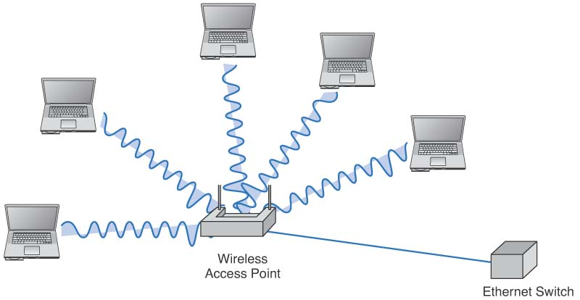
WLAN Topology
Same as Ethernet
Physical star
Logical bus
Use the same radio frequencies, so take turns using the network
10Base-T or 100Base-T
Uses a NIC that transmits radio signals to the AP
A wireless Access Point (AP) connected into an Ethernet Switch

Slide 15
WLAN Media Access Control
Uses CSMA/CA
CA → collision avoidance
A station waits until another station is finished transmitting plus an additional random period of time before sending anything
May use two MAC techniques simultaneously
Distributed Coordination Function (DCF)
Also called “Physical Carrier Sense Method”
Point Coordination Function (PCF)
Also called “Virtual Carrier Sense Method”
Optional: (can be set as “always”, “never”, or “just for certain frame sizes”)

Slide 16
Logical Link Control
controlled access
contention access
Point Coordination Function (PCF)
Data Link Layer
Distributed Coordination Function (DCF)
MAC
802.11a
802.11b
802.11g

Slide 17
Distributed Coordination Function
Relies on the ability of computers to physically listen before they transmit
When a node wants to send a message:
First listens to make sure that the transmitting node has finished, then
Waits a period of time longer
Each frame is sent using stop-and-wait ARQ
By waiting, the listening node can detect that the sending node has finished and
Can then begin sending its transmission
ACK/NAK sent a short time after a frame is received,
Message frames are sent a somewhat longer time after (ensuring that no collision will occur)

Slide 18
Distributed Coordination Function
Medium Idle?
Wait for frame to transmit
Wait IFS
Still
Idle?
Wait until current transmission ends
Transmit Frame
Wait IFS
Still
Idle?
Exponential Backoff
while medium idle?
Transmit Frame

Slide 19
Point Coordination Function (PCF)
Solves Hidden Node problem
Two computers can not detect each other’s signals
A computer is near the transmission limits of the AP at one end and another computer is near the transmission limits at the other end of the AP’s range
Physical carrier sense method will not work
Solution
First send a Request To Send (RTS) signal to the AP
Request to reserve the circuit and duration
AP responds with a Clear To Send (CTS) signal,
Also indicates duration that the channel is reserved
Computer wishing to send begins transmitting

Slide 20
IEEE 802.11g
Designed to combine advantages of 802.11a and 802.11b
Offers higher data rates (up to 54 Mbps) in 2.4 GHz band (as in .11b) with longer ranges
Backward compatible with 802.11b
.11b devices can interoperate with .11g APs
Price to pay: when an .11g AP detects an .11b device, it prohibits .11g devices from operating at higher speeds
Uses the same topology as .11b
Provides 3-6 channels (depending on configuration)
54 Mbps rate obtained within 50 meter range

Slide 21
IEEE 802.11n
Is now showing up in production equipment
Goal to provide high speed wireless networking
Uses both the 2.4 and 5 GHz frequency ranges simultaneously
Current drafts propose speeds of 100-200 Mbps

Slide 22
WI-FI as Public Internet Access
Wi-Fi was intended to be used for indoor mobile wireless access
Many providers have in airports and malls and other public places
Political issues, not technical, interfere with the large scale provision of Wi-Fi

Slide 23
WIMAX (Worldwide interoperability for Microwave Acess)
Commercial name for family of IEEE 802.16 standards
Two primary types: Fixed and mobile
Logical and physical topology same as 802.11 and shared Ethernet
Uses controlled access with a version of 802.11 point coordination function
Two types:
802.16d (fixed point wireless access)
802.16e (mobile user access)

Slide 24
WIMAX vs. Wi-Fi
Wi-Fi was originally intended to be a wireless extension of wired LAN.
WIMAX was intended for wireless MAN’s.
- LOS fixed stations BWA is in the range of 30 Miles vs 300 ft for Wi-Fi.
- The range for mobile stations is 3 – 10 miles.
WIMAX operates on both licensed and unlicensed frequencies in the 2 – 11 GHz
range and is less subject to interference than Wi-Fi
WIMAX can support QoS capabilities, and supports both LOS and NLOS
capabilities. (to accomplish this Clearwire sets it cellular towers
1.5 miles apart.)

Slide 25
WIMAX vs. Wi-Fi
The 802.16 standard covers the spectrum range 2 GHz – 66 GHz, however
the frequency ranges differ somewhat from country to country most
Implementations are in the range from 2 GHz – 11 GHz.

Slide 26
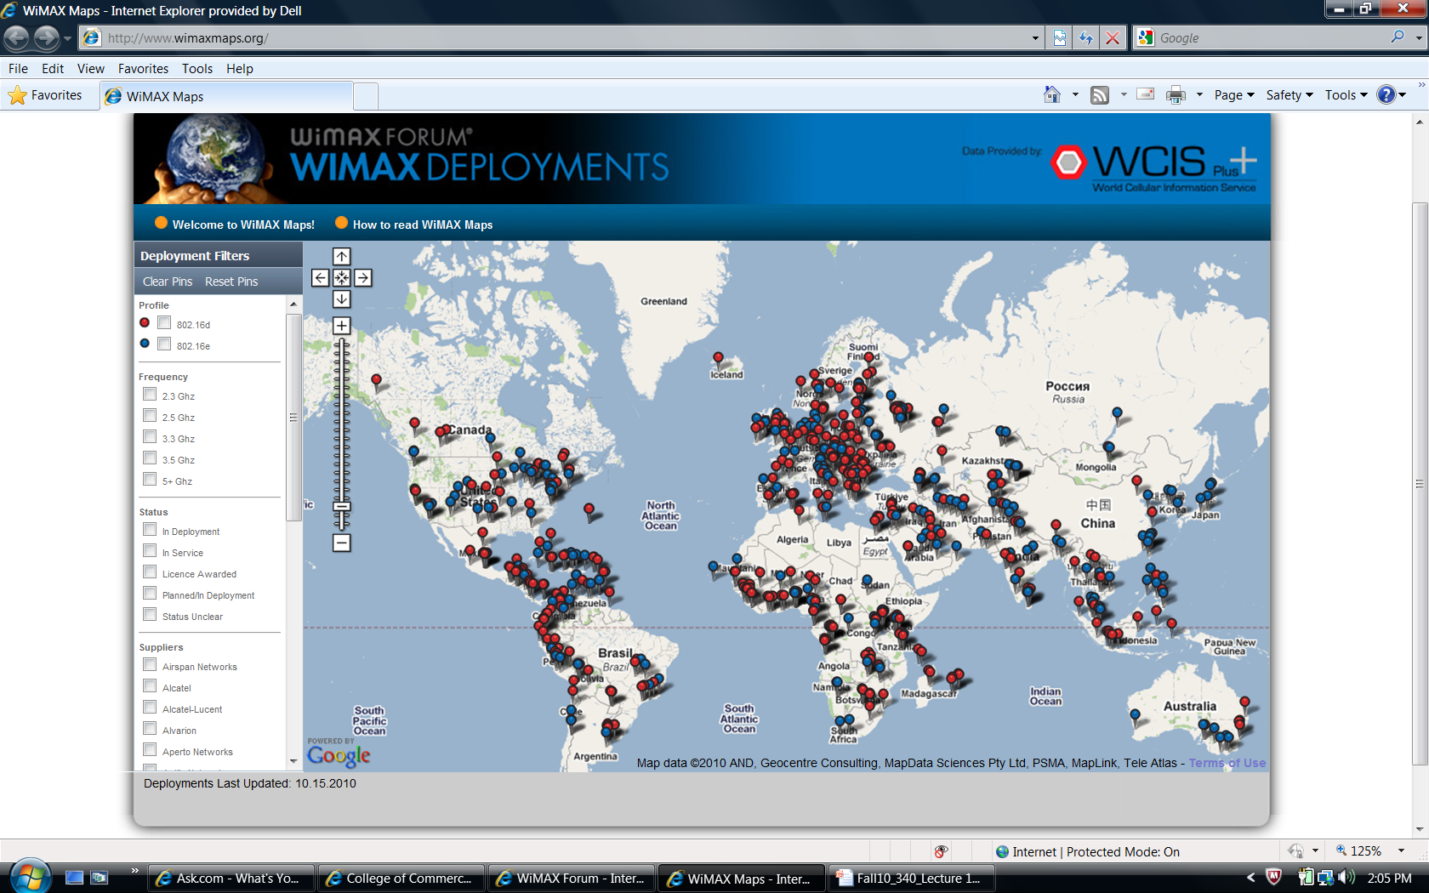
Data Communications for a Global Environment

Slide 27
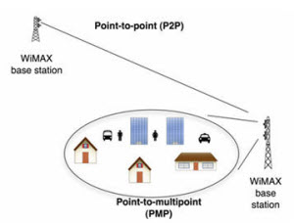
Data Communications for a Global Environment

Slide 28
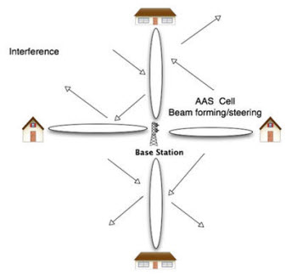
Data Communications for a Global Environment
Adaptive Antenna System (AAS)
Adaptive Antenna Systems (AAS) use beam-forming technologies to focus the wireless beam between the base station and the subscriber. This reduces the possibility of interference from other broadcasters as the beam runs straight between the two points.

Slide 29
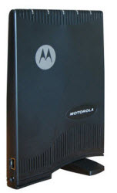
Data Communications for a Global Environment
Figure 16: Indoor WiMAX CPE, courtesy Motorola
The most significant advantage of indoor over outdoor CPE is that it is installed by the subscriber. This frees the service provider from the expense of "truck roll" or installation. In addition, it can be sold online or in a retail facility thus sparing the service provider a trip to the customer site. Indoor CPE also allows a certain instant gratification for the subscriber in that there is no wait time for installation by the service provider. Currently, many telephone companies require a one month wait between placement of order and installation of T1 or E1 services. In addition, an instant delivery of service is very appealing to the business subscriber in the event of a network outage by the incumbent service provider.

Slide 30
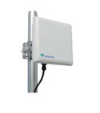
Data Communications for a Global Environment
Outdoor CPE
Figure 15: An outdoor CPE device
Outdoor CPE, very simply put, offers somewhat better performance over indoor CPE given that WiMAX reception is not impeded by walls of concrete or brick, RF blocking glass or steel in the building's walls. In many cases the subscriber may wish to utilize an outdoor CPE in order to maximize reception via a line of sight connection to the base station not possible with indoor CPE. Outdoor CPE will cost more than indoor CPE due to a number of factors including extra measures necessary to make outdoor CPE weather resistant.

Slide 31
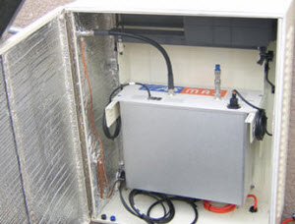
Data Communications for a Global Environment

Slide 32
Logical Link Control
controlled access
contention access
Point Coordination Function (PCF)
Data Link Layer
Distributed Coordination Function (DCF)
MAC
802.11a
802.11b
802.11g

Slide 33
Issues to consider with WIMAX
WIMAX is a competitor to public access Wi-Fi and cellular phone service
WIMAX is incompatible with both
Has an effective range that offers benefits
Has controlled access, version of PCF
Considerably more distance covered with WIMAX over Wi-Fi:
802.16d has a maximum real world effective range of 5 miles, 802.16e is 6 miles

Slide 34
Bluetooth (IEEE 802.15)
A standard for Wireless Personal Area Network (WPAN)
Provides networking in a very small area
Up to 10 meters (current generation)
Up to 100 meters (next generation)
Includes small (1/3 of an inch square) and cheap devices designed to
Replace short distance cabling between devices
Keyboards, mouse, handsets, PDAs, etc
Provides a basic data rate of up to 3 Mbps
Can be divided into several voice and data channels

Slide 35
Bluetooth Topology
Uses the term “piconet” to refer to a Bluetooth network
Consists of 8 devices
A “master” device controlling other devices, “slaves”
Acts like an AP
Selects frequencies and controls access
All devices in a piconet share the same frequency range

Slide 36
Bluetooth Media Access Control
Uses Frequency Hopping Spread Spectrum (FHSS)
Available frequency range (2.4000-2.4835) divided into 79 separate 1-MHz channels
A data burst transmitted using one channel, next data burst uses the next channel, and so on.
Channels changed based on a sequence and established by the slave and the master prior to the data transfers
1,600 hops or channel changes per second
Also used to minimize interference
A noisy channel avoided eventually
Not compatible with 802.11b
Potential interference problems (especially if many Bluetooth devices present close to .11b devices)

